Slide 1


BRACT’S
VISHWAKARMA INSTITUTE OF INFORMATION TECHNOLOGY PUNE.
Students Database using text files in java
Subject : Advanced data structure
Batch : B3 Year : SY
Name | Roll no
Sakshi tale | 222064
Rushikesh Taskar | 222065
Varad Latkar | 222066
Vipin Thombare | 222067
Makarand Wankhede | 222068
Tushar Wankhede | 222069

Slide 2
File Handling
File handling is an important part of any application.
Java has several methods for creating, reading, updating, and deleting files.
The File class from the java.io package, allows us to work with files.
To use the File class, create an object of the class, and specify
the filename or directory name:
There are several File Operations like creating a new File, getting information about File, writing into a File, reading from a File and deleting a File.

Slide 3
Text File and Binary File
Text File
It contains alphabets and numbers which are easily understood by human beings.
An error in a text file can be eliminated when seen.
In text file, the text and characters will store one char per byte.
For example, the integer value 4567 will occupy 2 bytes in memory, but, it will occupy 5 bytes in text file.
The data format is usually line-oriented. Here, each line is a separate command.
Binary file
It contains 1’s and 0’s, which are easily understood by computers.
The error in a binary file corrupts the file and is not easy to detect.
In binary file, the integer value 1245 will occupy 2 bytes in memory and in file.
A binary file always needs a matching software to read or write it.
For example, an MP3 file can be produced by a sound recorder or audio editor, and it can be played in a music player.

Slide 4
Important classes and functions
File writer
FileWriter is useful to create a file writing characters into it.
FileWriter is meant for writing streams of characters. For writing streams of raw bytes, consider using a FileOutputStream.
FileWriter creates the output file if it is not present already.
File reader
FileReader is useful to read data in the form of characters from a ‘text’ file.
This class inherited from the InputStreamReader Class.
FileReader is meant for reading streams of characters. For reading streams of raw bytes, consider using a FileInputStream.

Slide 5
hasNextLine()
The hasNextLine() method of java.util.Scanner class returns true if there is another line in the input of this scanner.
This method may block while waiting for input. The scanner does not advance past any input.
The function does not accepts any parameter.
Nextline()
NextLine()It read input from the the input device till input device till the line the space character. change.
It can read those words having space in it.
The escaping sequence of NextLine() is ‘\n’.

Slide 6
Bufferedreader class Info
The BufferedReader class of Java is used to read the stream of characters from the specified source (character-input stream). The constructor of this class accepts an InputStream object as a parameter.
It makes the performance fast. It inherits Reader classThis class provides a method named read() and readLine() which reads and returns the character and next line from the source (respectively) and returns them.
Instantiate an InputStreamReader class bypassing your InputStream object as a parameter.
Then, create a BufferedReader, bypassing the above obtained InputStreamReader object as a parameter & read data from the current reader as String using the readLine() or read() method.

Slide 7
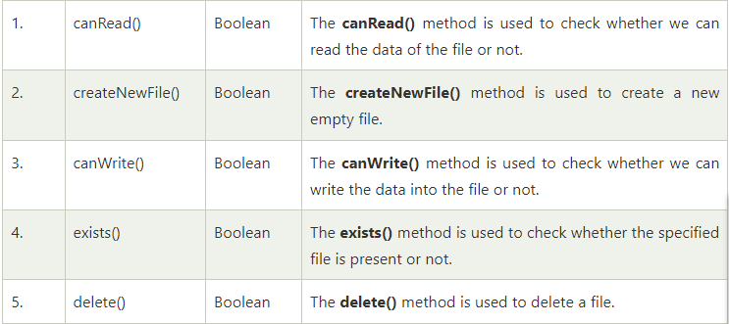
Java file class methods

Slide 8
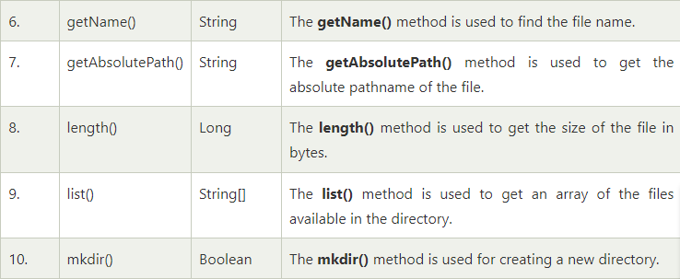

Slide 9
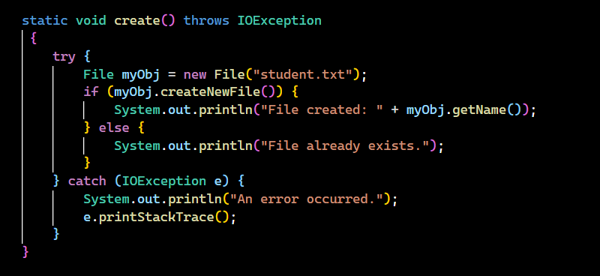
Student database operation
Create database (text file )

Slide 10
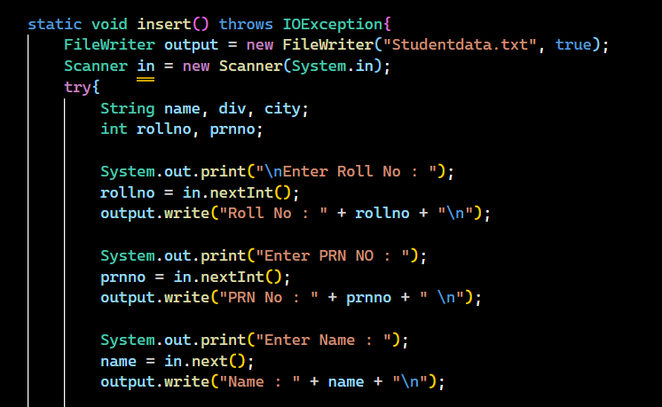
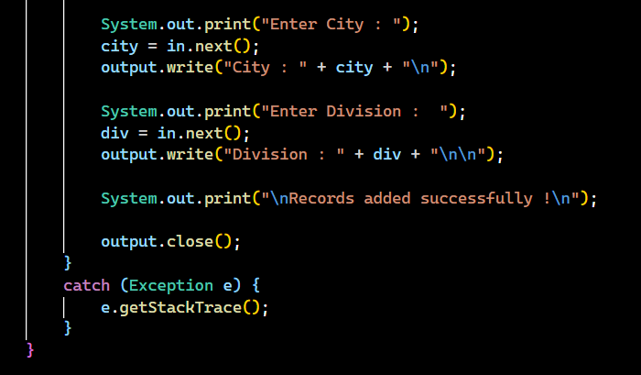
Insert students data

Slide 11
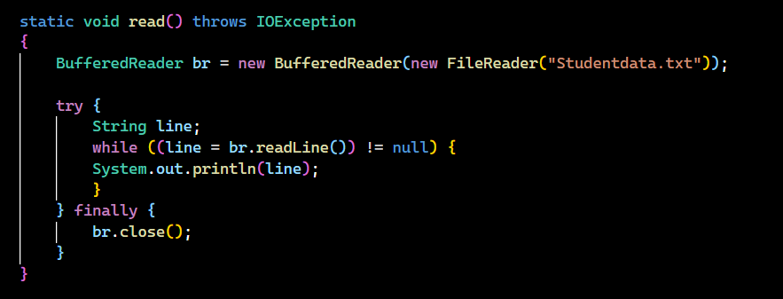
Read student data (information)

Slide 12
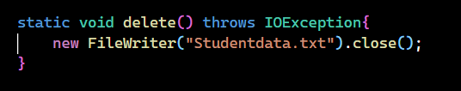
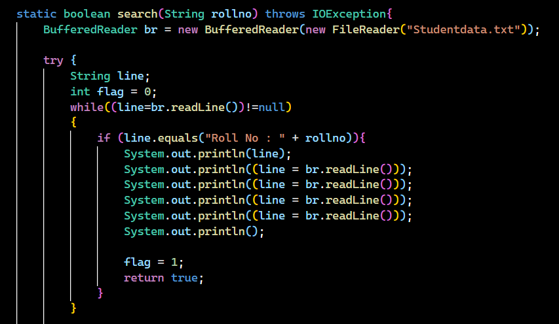
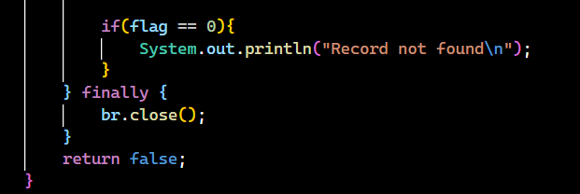
Delete data from text file
Search data from text file

Slide 13
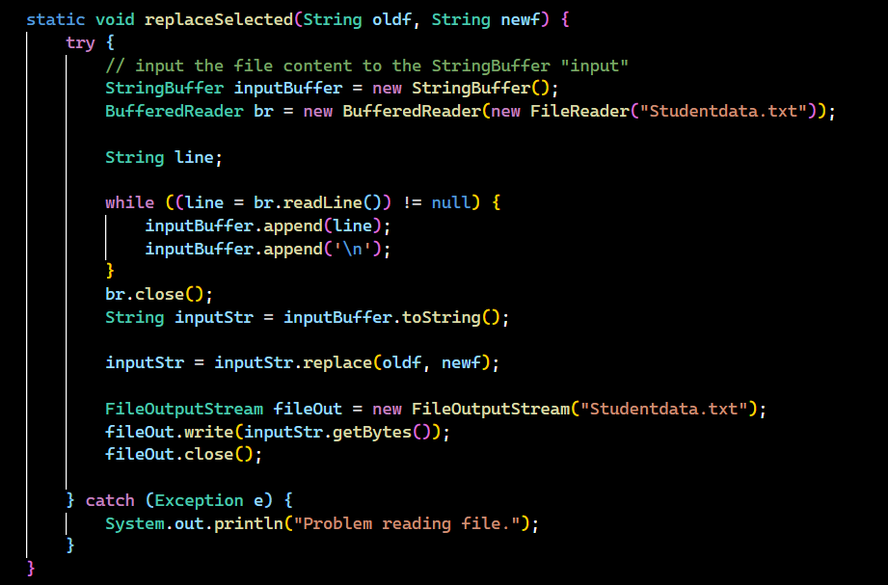
Update student data (information)

Slide 14
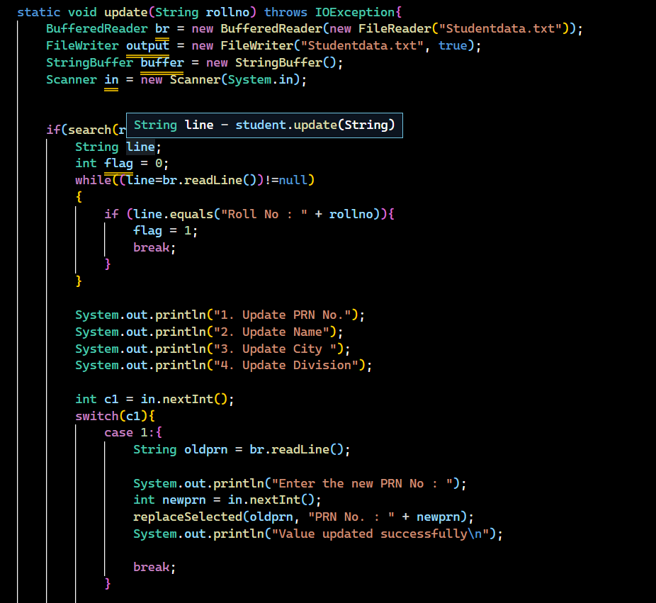
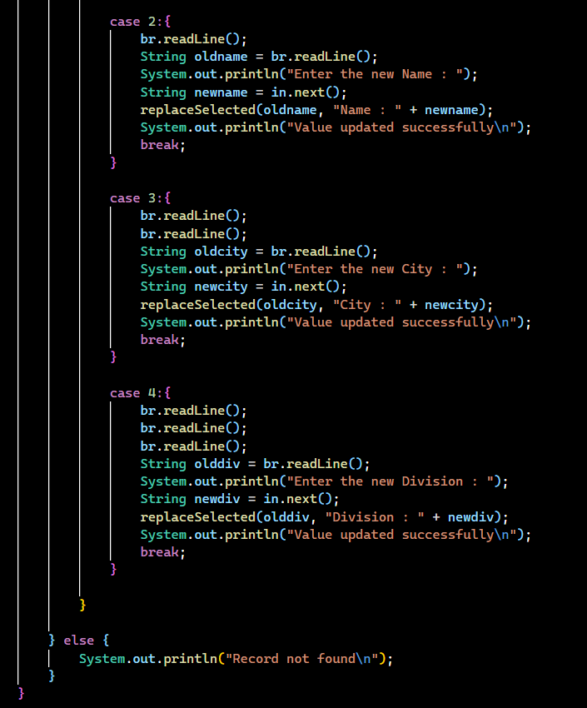

Slide 15
Advantages of file handling
File Handling in Java permits us to create, read.
It is also used to update, and delete the files, which are stored on the local file system.
There are two types of File handling in Java – FileWriter, and FileReader, which can perform all the file operations in Java Program

Slide 16
THANK YOU

